Slide 1
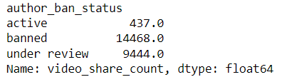
Claims classification project executive summaries
Executive summaries report
TikTok is working on the development of a predictive model that can determine whether a video contains a claim or offers an opinion. With a successful prediction model, TikTok can reduce the backlog of user reports and prioritize them more. At this stage of the project TikTok data Team preliminary investigate an initial available data in order to inform stakeholders if the data is sufficient for the project purpose and sufficient to the task providing meaningful inside of the data. efficiently.
Explored dataset to find any anomalies and unusual data
Find out which variables have the most influence on the claim status in order o use this variable in the following analysis (for this scenario is “author ban status” and “claim status”)
Check possible correlation between this two variables
Check for more inside within the data
Gain clear understanding of the datasets in order to proceed further in the project and provide detailed analysis, visualization and machine learning model
This dataset sufficient for creating prediction model for claim classification.
Some missing data has to be cleaned
The most influencial variables at the moment are claim starus and author ban status
Video sharing count
Compile summary information about the data
Clear data if required and analyze data in order to understand unusual variables (if any)
Create supplemental statistical data to support existing datasets and learn more about data
Create and run a regression model.

